Slide 1

FUEL FLOW DETECTOR

Slide 2
WHAT IS A FUEL FLOW DETECTOR?
OUR FUEL FLOW DETECTOR IS A DEVICE WHICH INSPECTS THE QUANTITY OF FUEL THAT IS BEING PUMPED INTO THE VEHICLE
(BIKES,CARS ETC..)
THE QUANTITY OF PUMPED FUEL WILL BE DISPLAYED IN THE LCD DISPLAY.
IN ADDITION,RATE OF FLOW WITH RESPECT TO TIME WILL ALSO BE DISPLAYED.
THROUGH THIS DEVICE,FUEL SCAM OF PETROL BUNKS WILL BE PREVENTED.

Slide 3
OBJECTIVES
* THE MAIN OBJECTIVE OF THIS PROJECT IS TO GIVE AN
INNOVATIVE SOLUTION TO HANDLE THE THEFT OF FUEL IN
PETROLEUM BUNKS WITHOUT ANY HUMAN INTERVENTION.
* TO ENSURE THE ACCURATE FLOW OF FUEL.
* TO MAKE IT AFFORDABE AND HANDY

Slide 4
FLOW CHART
FUEL SUPPLY
FLOW
SENSOR
FUEL TANK
ARDUINO UNO
OLED DISPLAY

Slide 5
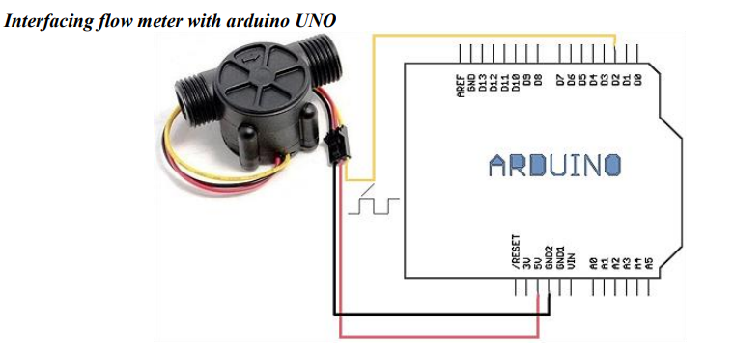
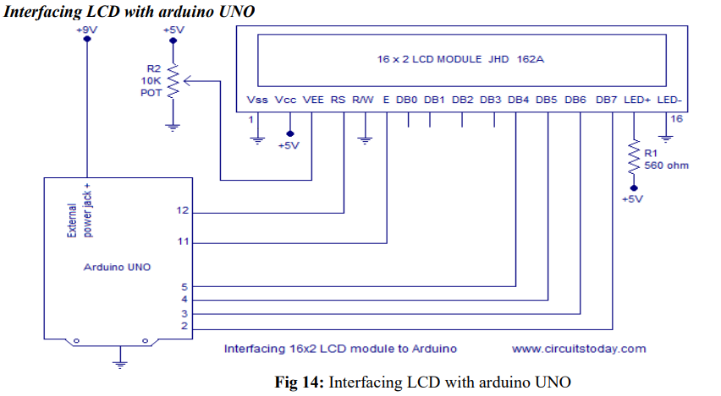
CIRCUIT DIAGRAMS
FLOW METER WITH ARDUINO UNO
INTERFACING LCD WITH ARDUINO

Slide 6
WORKING
* THE FUEL IS PUMPED INTO THE FUEL TANK IN THE FUEL FILLING STATIONS.
* THE FLOW SENSOR METER IS PLACED AT THE MOUTH OF THE FUEL TANK OPENING.
* THE FLOW SENSOR IS CONTROLLED WITH A CUSTOMIZED PROGRAMMED ARDUINO UNO.
* THE READINGS WILL BE DISPLAYED ON THE DASHBOARD WITH A LCD DISPLAY.

Slide 7
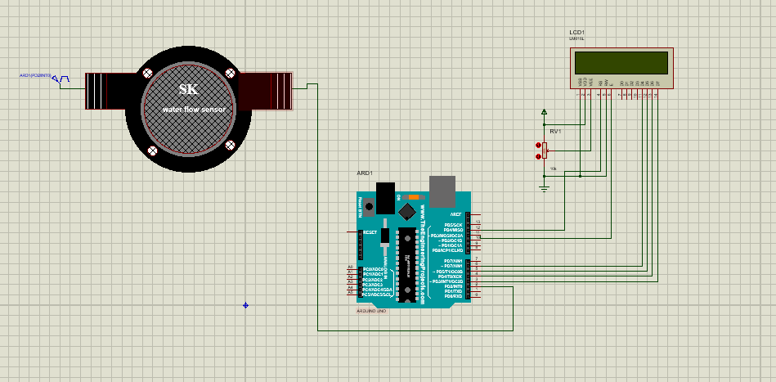
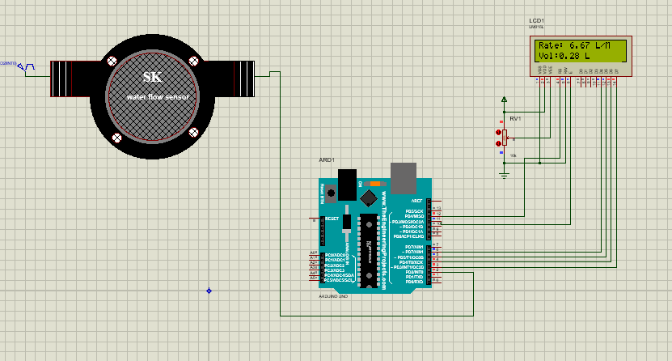
PROTEUS OUTPUT

Slide 8
ADVANTAGES
* It is cheap and is safe to handle.
* Since the components used in this system are of low cost, it is easily affordable.
* There need not be any fear of malfunctioning.
* It requires less maintenance.
* It is easy to use and it does not require any skill to operate it.
* It is hands free and the output will be displayed on the screen.
* It gives values exactly and precisely.

Slide 9
CONCLUSION
A lot of fuel is sometimes being stolen by petroleum bunks.
It is our right to get the exact amount of fuel for which we pay.
Our project helps in overcoming this issue.
This project has been designed to serve the community who owns and uses cars running on gasoline fuel.
It has been designed by keeping the problem of the common man in mind.
Thus we conclude that our product will serve good in inspecting fuel flow in a cost efficient manner.

Slide 10

THANK YOU !

